Slide 1
Health Law 2022: State Attorneys General & Emerging Trends

Slide 2
Why Do Healthcare Companies Need to Pay Attention to State AGs?
State AGs are their state’s Chief Legal Officer
They wield broad authority to investigate and take action on virtually any subject and in any industry. They also counsel and represent state agencies and boards
The COVID pandemic has seen them become more active in pursuing price-gougers, labor & employment violations, misleading marketing of COVID treatments and “cures,” data privacy, and False Claims Act infringements
State AGs are increasingly coordinating multi-state actions to investigate and take enforcement action against businesses they perceive are operating in ways that disadvantage consumers
State AGs can be powerful allies for businesses. Strong relationships with AG offices can allow a company to educate regulators about its business or industry and shape the narrative before a competitor or adversary does

Slide 3
Potential Issue Areas
All actors in the healthcare industry are confronting increased state AG interest. Potential issue areas include:
Prescription and distribution of opioids
Deceptive and unfair trade practices
Data privacy, security, and potential breaches
Medicaid fraud
Telehealth and digital services
Antitrust violations
COVID-related fraud and other issues

Slide 4
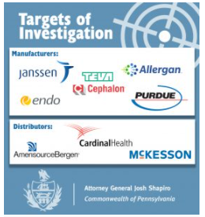
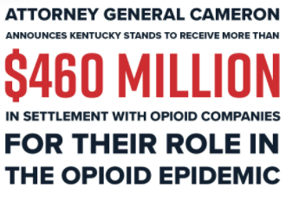
Prescription & Distribution of Opioids
State AGs continue to identify opioid remediation as one of their biggest priorities.
Unless otherwise noted, headlines are sourced from state AG websites.

Slide 5
Prescription & Distribution of Opioids
AGs have sued individual healthcare providers, manufacturers, distributors, pharmacies and marketing consultants
2/4/21: AG Slatery Sues Food City for Unlawful Sales of Opioids
3/15/21: Attorney General Rutledge Files Opioid Lawsuit Against Walgreens
4/2/21: Attorney General Alleges Deceptive Marketing by Opioid Manufacturers Teva, Cephalon, and Allergan
5/6/21: AG Healey Sues Multinational Marketing Firm for Role in Fueling the Opioid Crisis
6/2/21: Attorney General Cameron Sues CVS for Company’s Role in Opioid Epidemic

Slide 6
Prescription & Distribution of Opioids
Litigation by AGs is underway, but has led to mixed results
Orange County Court ruled in favor of several opioid manufacturers, in litigation brought by Orange, Santa Clara, and Los Angeles Counties, along with the City of Oakland
Oklahoma Supreme Court overturned the $475 million verdict against opioid manufacturer Johnson & Johnson
WV AG trial against AmerisourceBergen, Cardinal and McKesson began in May 2021 and ended in July
No judgment yet from Court
WA AG trial against the same 3 distributors began on 11/15/21 and is pending as of 12/8/21

Slide 7
Opioid Settlements
Multiple settlements were announced in 2021 – expect more in 2022
2/4/21: Attorney General Phil Weiser leads states to reach $573 million national settlement with McKinsey & Company for its role in ‘turbocharging’ the opioid epidemic with Purdue Pharma
7/21/21: Attorney General Bonta Announces Proposed $26 Billion Settlement with Opioid Distributors and Opioid Manufacturer Johnson & Johnson
Similar settlements announced with NY the month prior
9/16/21: AG Yost Announces Ohio's Historic $808 Million Settlement with Opioid Distributors
10/27/21: Attorney General Brnovich Obtains Over $400,000 from Scottsdale Doctor for Opioid Prescriptions

Slide 8
Distribution of Opioid Settlement Funds
State AGs are working with their local governments (cities and counties), state health departments, and legislatures to coordinate sign-on and distribution of settlement funds
See e.g., KY House Bill 427

Slide 9
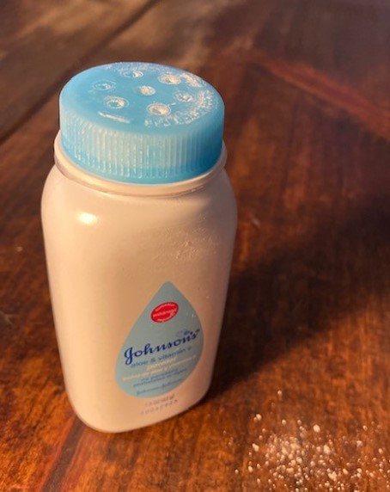
Deceptive & Unfair Trade Practices
Products (as manufactured and used) must comply with state UDAP laws
Products for sale must not contain illegal or unsafe ingredients
State AGs often take the position that knowing failure to disclose risks is a UDAP violation
Product labels must comply with state UDAP laws and the federal Food, Drug & Cosmetic Act
State AGs have alleged failure to comply with FDCA = violation of their UDAP laws
Some state AGs have state law equivalents to FDCA, with ability to enforce
May allege that failure to comply with such laws = violation of their UDAP laws

Slide 10
Deceptive & Unfair Trade Practices
Marketing and advertising must be clear and not misleading
Limitations related to products, services must be disclosed - and understandable to a reasonable consumer
Many state AGs can bring a UDAP claim for material omissions
2/15/21: Bristol-Myers, Sanofi ordered to pay Hawaii $834 million over Plavix warning label [Source: Reuters]

Slide 11
Deceptive & Unfair Trade Practices Cont.
Health claims must be substantiated
State AGs generally apply the same substantiation standard applied by the FTC – “competent and reliable scientific evidence”
8/17/21: Carr, FTC Hold Companies Accountable for Deceptive Claims Regarding Stem Cell Therapy
11/24/21: Attorney General James Secures $5.1 Million Judgment Against New York City Stem Cell Clinic for Scamming Patients Out of Thousands Through False Advertising
Status, affiliation and approval claims must be true
5/11/21: Attorney General Brnovich Obtains Settlement with Arizona Hearing Device Company to Stop Deceptive Advertising
Providers must avoid engaging in “unfair” tactics to drive sales (i.e. kickbacks)

Slide 12
“Fair” & Transparent Pricing
States AGs increasingly advocating for transparent and “fair” healthcare pricing
This extends to both services and prescriptions – and across the political spectrum
6/8/21: AG Lynn Fitch Files Lawsuit Against Insulin Manufacturers and PBMs Over Insulin Pricing Scheme
Some AGs are taking particular aim at “surprise billing” practices
The UDAP claim arises from an alleged failure to disclose a material fact
6/2/21: AG Secures $260,000 From South Shore Anesthesia Provider to Settle Alleged Unfair “Surprise Billing” Practices
MA AG alleged failure to adequately disclose “out of network” status →bills for “unfairly high charges”
Settlement included restitution and debt cancellation for affected consumers

Slide 13
Medicaid Fraud
There is a special Medicaid Fraud Control Unit in all states but one, and many are housed in the AG’s Office
Because Medicaid is run jointly by the states and the feds, healthcare providers being investigated for fraud in the delivery of healthcare may face the combined forces of the USDOJ and state AGs
These cases can be civil, criminal or both
Kickbacks that violate state or federal law are a frequent target for enforcement, as well as false claims

Slide 14
Medicaid Fraud
State AGs pay close attention to pricing and billing issues, particularly when it comes to billing of the government through Medicaid
11/10/21: Attorney General Ford Announces Sentencing of Las Vegas Medicaid Provider Aaron Williams
States such as Massachusetts have been especially active this year in this area
11/18/21: AG Healey Secures $800,000 From Jamaica Plain Pharmacy Over Unlawful Auto-Refill Practices and Billing MassHealth for Prescriptions That Were Not Provided
11/19/21: AG Healey Secures $1.2 Million From Brockton Home Health Agency That Falsely Billed MassHealth
11/19/21: AG Healey Sues Home Health Agency for Providing Services Without Physician Authorization

Slide 15
Telehealth & Other Digital Services
The pandemic renewed state AG attention to telehealth and digital services
Many state AGs expressly supported legislation removing barriers to telehealth services that long-existed in their respective states
“If the current regulations on telehealth weren’t needed in the midst of a global pandemic, they weren’t necessary in the first place,”
- Montana Attorney General Austin Knudsen regarding HB 43
Consumer protection investigations were launched, focusing on deceptive advertising claims, failure to deliver products or services, and whether providers (e.g. online pharmacies) were in compliance with state licensing laws

Slide 16
Telehealth & Other Digital Services
Digital service providers should heed cross-border licensing requirements and state board jurisdictional authority
State AGs may coordinate with other state agencies/boards with concurrent jurisdiction
Brick-and-mortar establishments are lobbying state AGs to encourage them to exert greater regulatory control over telehealth providers
Many online providers are aware of this activity and are seeking to combat it with their own messaging
Connected devices and health data collection is also drawing increased AG scrutiny

Slide 17
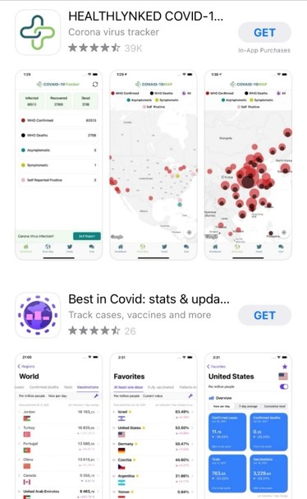
Telehealth & Other Digital Services
Contact tracing drew particular attention from State AGs during the pandemic
Some AGs vocally supported the introduction of new legislation to address privacy concerns
“While contact tracing is a familiar tool to the public health community, the anticipated scope of expansion of the practice during the COVID-19 pandemic is certain to present challenging legal issues not addressed by current Kansas law,”
– AG Derek Schmidt
Others engaged directly with industry and large technology providers
6/16/20: Attorney General Rosenblum Leads Coalition Calling on Apple and Google to Ensure Consumer Privacy is Protected with Contact Tracing Apps

Slide 18
Telehealth & Other Digital Services
FTC’s Health Breach Notification Rule
Requires certain entities that collect or use health information to notify consumers, the FTC, and, in some cases, the media, if they experience a data breach
FTC can seek $43,792 per violation per day – although it has not yet enforced the Rule
No express authority for AG enforcement, but any enforcement by FTC would likely trigger AG scrutiny
Any violation of Rule “shall be treated as an unfair or deceptive act or practice” under the FTC Act
On 9/15, the FTC issued a Policy Statement clarifying that the Rule:
Applies to health app and connected device developers if “they can draw data from multiple sources, and are not covered by a similar rule issued by the Department of Health and Human Services”
Requires notification for any unauthorized disclosure of individual personal health information, including sharing of covered information without an individual's authorization

Slide 19
Antitrust: Mergers, Price Fixing & Non-Compete Investigations
Antitrust matters are garnering increased attention from state AGs, in general
Anticompetitive mergers remain a primary concern for many AGs
11/8/21: AG Shapiro Leads Bipartisan Coalition of 26 AGs to Address Impact of Anticompetitive Hospital Merger on Consumers
Price fixing and “pay-for-delay” investigations (and litigation) show no signs of abating
2/25/21: Attorney General Balderas Files Suit Against Manufacturers of Antiretroviral HIV/AIDS Treatment Drugs
9/13/21: Attorney General Tong Announces $1.6 Million Antitrust Settlements With Two Connecticut Based Physician Practice Management Companies and Two Connecticut Fertility Clinics
State AG generic drugs litigation continues
1/28/21: Court Unseals States' Latest Generic Drug Complaint, Including Excerpts from "Diary of Collusion" Meticulously Documenting Widespread Price-Fixing

Slide 20
COVID-Related Fraud & Deception
Throughout the pandemic, AGs have used both their consumer protection authority (and their bully pulpits) to combat COVID-related consumer fraud and protect the public against:
Price gouging on (or failure to deliver) PPE, hand sanitizer, and other consumer products
10/27/21: Rutledge Sues Company for Scamming UAMS for More Than $10-Million in COVID-19 PPE, Ventilators
Bogus testing, preventative products, treatments, and cures
8/18/21: AG Nessel Reaches Agreement with Michigan Business Over Alleged False COVID-19 Prevention Claims
COVID-related phishing and imposter scams offering testing or vaccines
Refund, cancellation policies

Slide 21
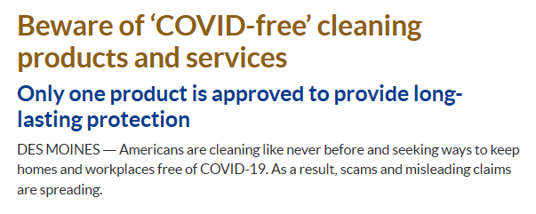
COVID-Related Fraud & Deception
Albany Times Union
A statement does not have to be literally false to be illegal; any claim that is likely to mislead a consumer may result in action by the Attorney General’s Office. Compliance with federal requirements or industry standards is not a defense to liability under California law.

Slide 22
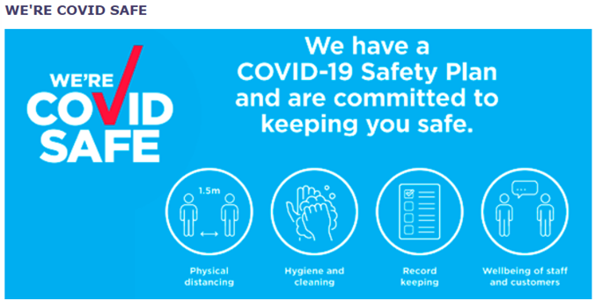
Advertising Best Practices
Avoid misleading language
Include material terms
Ensure you have substantiation for claims
Train all employees, especially managers and supervisors, on the importance of advertising disclosures and truth-in-advertising
Track all complaints, especially from regulators

Slide 23
Other COVID Issues
AGs have turned their attention to tertiary COVID issues, including…
Labor and employment practices
11/15/21: In Nationwide First, Attorney General Bonta Secures Judgment Requiring Amazon to Comply with “Right-to-Know” Law to Help Protect Workers Against COVID-19
11/16/21: Attorney General James and NYC Department of Consumer and Worker Protection Recover Up to $18.8 Million in Unpaid Wages for 12,000 Home Health Aides: AG’s Investigation Revealed Two Home Care Health Agencies Violated Workers’ Rights and Denied Fair Compensation

Slide 24
Other COVID Issues
Even when not the target, healthcare industry actors are being impacted by state AG actions
Multiple federal vaccine mandate challenges brought by state AGs in 2021
11/29/21: AG Derek Schmidt obtains new injunction blocking Biden administration’s vaccine mandate for health care workers in Kansas
11/29/21: Court Halts Biden Administration’s Healthcare Worker Vaccine Mandate Following Lawsuit from Missouri Attorney General

Slide 25
Data Privacy & Security
State data privacy laws in CA, VA and CO provide (or will soon provide) consumers in those states with certain rights regarding the collection, use and disclosure of their personal information
Business should carefully analyze whether these laws apply to them
California Consumer Privacy Act (CCPA) & Consumer Privacy Rights Act (CPRA)
Virginia Consumer Data Protection Act (VCDPA)
Colorado Privacy Act (CPA)
Similar legislation was introduced and nearly passed in a number of other states last year – expect similar laws elsewhere soon
HIPAA-covered entities or data may be exempt from certain state laws or provisions thereof
Requires state-by-state analysis

Slide 26
Comprehensive State Data Privacy Laws
California (2018) - Consumer Privacy Act (CCPA)
Creates consumer rights to access, delete and opt-out of the sale of personal information
Exempts medical information protected by HIPAA, the California Confidentiality of Medical Information Act and other federal laws
See Cal. Civ. Code § 1798.145(c)(1)(A)-(C)
Broadly defines “sale” of personal information
Any sharing for “valuable consideration” – not just money
Imposes first-ever Global Privacy Control obligations in the U.S.
Notice and right to cure within 30 days will sunset in January 2023
Effective January 1, 2020
Enforcement letters began going out on July 1, 2020

Slide 27
Comprehensive State Data Privacy Laws
California (2020) - Consumer Privacy Rights Act (CPRA)
Builds upon the CCPA
Includes right to correct incorrect personal information and right to limit the use/disclosure of “sensitive personal information”
Expands CCPA exemptions to include certain biometric research
Creates the CA Privacy Protection Agency
AG retains enforcement authority
Regulations anticipated by July 1, 2022
Effective January 1, 2023
Enforcers can “look back” to January 1, 2022

Slide 28
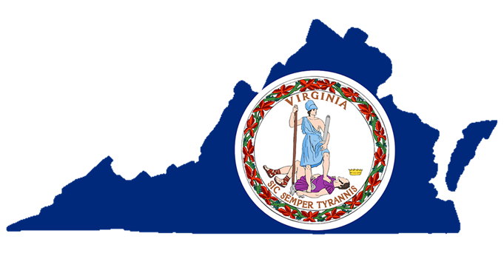
Comprehensive State Data Privacy Laws
Virginia (2021) – Consumer Data Protection Act
Draws heavily from the CCPA, CPRA and GDPR
Broad exemptions for certain entities and types of data
Including covered entities and business associates subject to HIPAA +
PHI under HIPAA
AG exclusive authority to enforce violations
No private right of action
Effective January 1, 2023

Slide 29
Comprehensive State Data Privacy Laws
Colorado (2021) – Colorado Privacy Act
A hybrid between CA and VA models
Applies equally to profit and non-profit entities, but certain types of data exempt
Exempts PHI collected by covered entities and business associates under HIPAA
Contains numerous other healthcare-related exemptions, see Colo. Rev. Stat. § 6-1-1304
AG and District Attorneys have exclusive authority to enforce violations
No private right of action
Effective July 1, 2023

Slide 30
2021 Legislative Landscape – A Preview for 2022?
Map Credit: Int’l Association of Privacy Professionals

Slide 31
Data Breaches & Ransomware
State AGs continue to take the disposal of paper records and electronic devices containing PHI and PII (personally identifiable information) very seriously
5/6/21: Rutledge Files Lawsuit Against 501 Pain and Rehab Clinics and Others for Dumping Patients’ Personal Information in Public Park
Ransomware attacks are on the rise and state AGs are reminding the healthcare industry of their obligations to guard against these attacks
Incident response plans should be in place – know your breach reporting obligations

Slide 32
Breach Prevention Best Practices
Keep all operating systems and software housing health data current with the latest security patches
Install and maintain virus protection software
Provide regular data security training for staff members that includes education on not clicking on suspicious web links and guarding against phishing emails
Restrict users from downloading, installing, and running unapproved software
Maintain and regularly test a data backup and recovery plan for all critical information to limit the impact of data or system loss in the event of a data security incident
Source: California DOJ Bulletin, Aug. 24, 2010. See also https://www.cisa.gov/stopransomware

Slide 33
Questions?
Meghan Stoppel
Member, State AG Group
Cozen O’Connor
720-479-3880
mstoppel@cozen.com

